Slide 1
How to Build a Router
Prepared by Ciena, 2025

Slide 2
Introduction
Building a router from scratch may sound intimidating! In this presentation, we will de-mystify routers and break down the ins and outs of their design.

Slide 3
What is a router?
Let’s start simple.
A router is a box - a box that takes an input, processes it, and produces some output.
Mathematically speaking:
Function(input) = output
We’ll soon discuss different types of input, output, and the properties of this function!
Notes:
Let us start simple. A router is a box. A box where you give it some inputs and it will give some outputs. So mathematically speaking:
output = Function(input)
Then we need to know what kinds of inputs, outputs are there and think of the properties of Function.

Slide 4
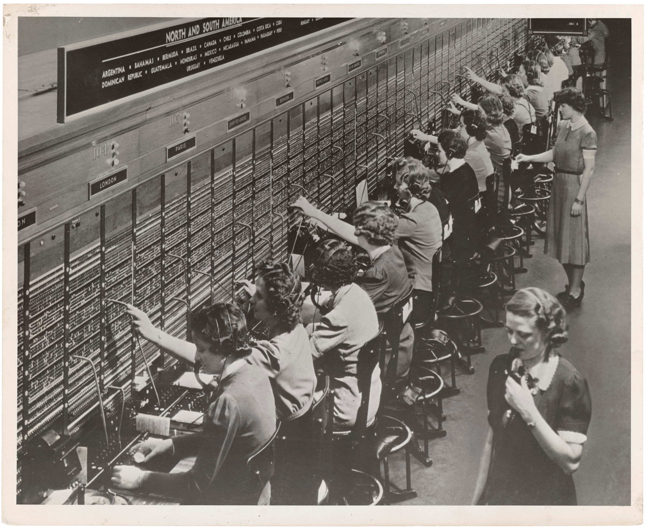
The Telephone Switchboard
What came before the router? The Telephone Switchboard!
In the late 1800s, switchboard operators would connect calls by putting plugs into jacks on a manual switchboard.
Routers are the new switchboard operator + switchboard.
Source: https://culturexchange1.wordpress.com/2015/06/02//the-telephone-switchboard-the-story-of-a-revolutionary-instrument

Slide 5
The Telephone Switchboard
Visual Example:
User1 Switchboard Operator User2
1. |-----------> User1: Hello Operator, I want to call User2
2. Switchboard Operator connects the ports of User1 and User2
3. |----------------------------------------------------------------------------------------------------|
User1 and User2 can now talk!

Slide 6
Back to Routers
We can think of a router as a stateful function:
Function(input) = output
We can categorize input into two types:
Data traffic (e.g., the call between User1 and User2)
Control traffic (e.g., traffic that mutates the state of the router)
A Stateful Function is one that remembers past events, influencing how it handles future inputs. For example, the same data packet may take different paths depending on the router’s current state.
Notes:
We see that the input can be categorized into 2 types: data traffic(the call) and control traffic (”help me connect to User2”)
Function is Stateful. After some events, in this case a control traffic, mutates the state of the router, same input might have different output. (For example, before you send a control traffic that disable some feature, you will handle that feature but ignore that feature after you disable it.)

Slide 7
The Coding Challenge
You will be provided two files: router.py and simulation.py.
You will need to implement the logic of router.py to cover 5 Router Use Cases (we will talk about these next).
Instead of processing real data packets, router.py will process integers to simulate the behaviour of a real router.
Setup Instructions:
Run simulation.py
Run router.py
Notes:
You task is to complete as many of the 5 test cases as possible.
Instead of processing real packets, we will just use some simple integers to simulate the behavior of how a real router is going to process the packets.
Now let us revisit the 5 use cases and use our “simulated” integer outputs as examples for input/output.

Slide 8
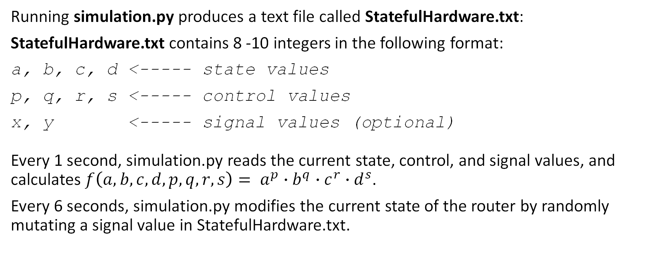
simulation.py
Running simulation.py produces a text file called StatefulHardware.txt:
StatefulHardware.txt contains 8 -10 integers in the following format:
a, b, c, d <----- state values
p, q, r, s <----- control values
x, y <----- signal values (optional) Every 1 second, simulation.py reads the current state, control, and signal values, and calculates ${f\left(a, b, c, d, p, q, r, s\right)= a}^{p}∙b^{q}∙c^{r}∙d^{s}$.
Every 6 seconds, simulation.py modifies the current state of the router by randomly mutating a signal value in StatefulHardware.txt.
Notes:
You task is to complete as many of the 5 test cases as possible.
Instead of processing real packets, we will just use some simple integers to simulate the behavior of how a real router is going to process the packets.
Now let us revisit the 5 use cases and use our “simulated” integer outputs as examples for input/output.

Slide 9
The 5 Use Cases
There are 5 Router Use Cases you need to know for this challenge:
Case 1: Forwarding Data Traffic
Case 2: Handling Control Traffic
Case 3: Management Functionality
Case 4: Handling Cron Jobs
Case 5: Recovery & Documentation
Notes:
You task is to complete as many of the 5 test cases as possible.
Instead of processing real packets, we will just use some simple integers to simulate the behavior of how a real router is going to process the packets.
Now let us revisit the 5 use cases and use our “simulated” integer outputs as examples for input/output.

Slide 10
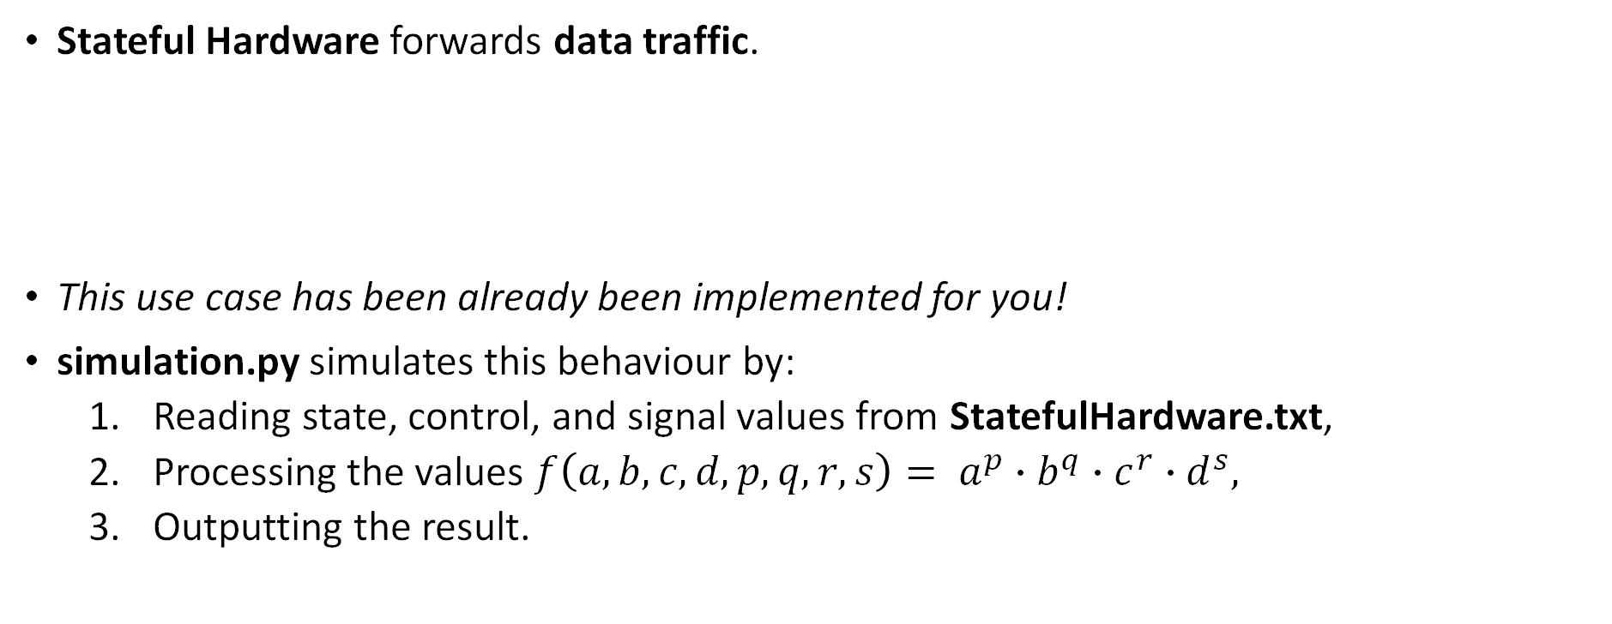
Case 1: Forwarding Data Traffic
Stateful Hardware forwards data traffic.
This use case has been already been implemented for you!
simulation.py simulates this behaviour by:
Reading state, control, and signal values from StatefulHardware.txt,
Processing the values ${f\left(a, b, c, d, p, q, r, s\right)= a}^{p}∙b^{q}∙c^{r}∙d^{s},$
Outputting the result.
Stateful Hardware
Notes:
Recall: Running simulation.py produces a file called StatefulHardware.txt. This file simulates the hardware by storing its state values, control values, and signal values.
In that txt file we have 4 integers separated by “,”
a, b, c, d
p, q, m, n
For example, for an instance of StatefulHardware.txt’s 1, 2, 3, 4
2, 3, 5, 7
We will calculate f(txt file) = p^a * q^b * m^c * n^d.
= 2^1 * 3^2 *5^3*7^4
And Given a random start time of our program, you will start to get a sequence of output numbers of snapshots of f(a,b,c,d) and we will use that sequence to verify your program behavior is correct.

Slide 11
Case 2: Handling Control Traffic
Stateful Hardware
Stateful Hardware senses control traffic, then notifies Service through Hardware API.
Service processes this traffic (with help from Service Database), then sends instructions back to Stateful Hardware through Hardware API.
Hardware receives the instruction and changes its state (i.e., changes how it forwards data traffic).
Hardware API
Service
Service Database
Example: User1 tells Switchboard Operator “I want to call User2.” Switchboard Operator looks at his table and sees the call from User1 comes from Port 1, and User2 is on Port2. The Switchboard Operator connects Port1 and Port2 with a jack.
Notes:
Case2: Stateful hardware senses control traffic and somehow notifies Service through Hardware API. Then Service calculates the Action (API that should be fired to Hardware API) that needs to be performed. Then after firing the Hardware API, Hardware will change its state(how to forward data traffic).
User 1 tells switchboard operator “I want to call User 2”.
Switchboard operator looks up his table and see that call comes from User 1 Port 1 and User 2 is port 2.
Then he connects Port 1 and 2.

Slide 12
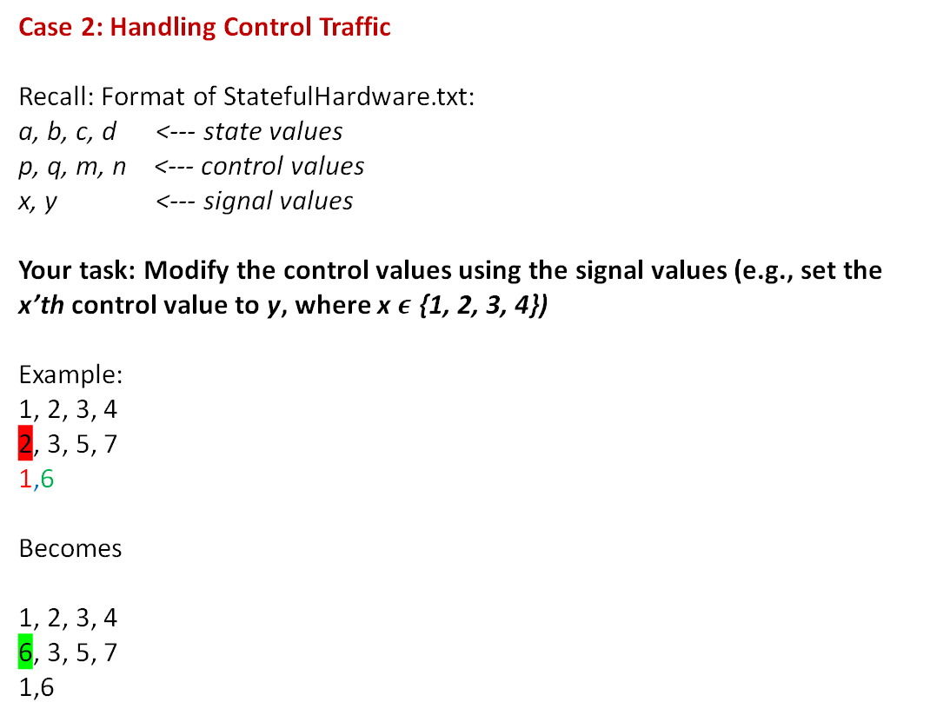
Case 2 Implementation
Case 2: Handling Control Traffic
Recall: Format of StatefulHardware.txt: a, b, c, d <--- state values
p, q, m, n <--- control values
x, y <--- signal values
Your task: Modify the control values using the signal values (e.g., set the x’th control value to y, where x $ε$ {1, 2, 3, 4})
Example:
1, 2, 3, 4
2, 3, 5, 7
1,6
Becomes
1, 2, 3, 4
6, 3, 5, 7
1,6
Stateful Hardware
Hardware API
Service
Service Database

Slide 13
Case 3: Management Functionality
Scenario:
User1 hasn’t been paying their phone bills, and the manager wants to cut their service.
We need to introduce an ADMIN interface (CLI) so that the manager can make modifications to the switchboard.
Switchboard Example:
Manager tells the Switchboard Operator: “I want to cut User1’s service!”
The Switchboard Operator sees User1 is mapped to Port 1. He unplugs Port 1 (even though User1 is currently on a call with User2). Then, he disables Port 1, blocking any control and data traffic.
Notes:
There is another use case:
Let us introduce the Manager!
Manager says, User1 haven't been paying for month and we are to cut their service!
This means we need to add the feature for Management functionality and thus introduce ADMIN interface (CLI) for managers to give orders.
Example: Manager tells switchboard operator “I want to cut wires for User 1.” Switchboard operator looks up his table and see what needs to clean up. In this case, User 1 is mapped to Port 1. Then he performs the clean up action on the switchboard. For example, unplug the User 1’s Port 1 immediately even though User 1 is currently calling User 2. Then he disables Port 1. In the future, noise(control traffic and data traffic) from Port 1 will not even wake up the operator as Port(stateful hardware) is disabled.

Slide 14
Case 3: Management Functionality
The manager sends an ADMIN signal from ADMIN Interface to Service.
The Service processes the ADMIN signal (with help from Service Database), then sends instructions to Stateful Hardware through Hardware API.
Stateful Hardware changes its state (e.g., to block port 1)
Stateful Hardware
Hardware API
Service
Service Database
ADMIN interfaces
Notes:
Case3: Nothing special happen on stateful hardware, but ADMIN signals were sent through ADMIN interfaces. Then Service calculates the Action (API that should be fired to Hardware API) that needs to be performed by reading and (maybe writing) the Service Database. Then after firing the Hardware API, Hardware will change its state(how to forward data traffic).
Example will be:
Manager tells switchboard operator “I want to cut wires for User 1”.
Switchboard operator looks up his table and see what needs to clean up. In this case, User 1 is mapped to Port 1.
Then he performs the clean up action on the switchboard. For example, unplug the User 1’s Port 1 immediately even though User 1 is currently calling User 2. Then he disables Port 1. In the future, noise(control traffic and data traffic) from Port 1 will not even wake up the operator as Port(stateful hardware) is disabled.

Slide 15
Implementing Case 3
In router.py, you must implement a CLI so that a manager can send the following command to modify the hardware’s state values.
The command should have the following format:
set j k
where j = index (1-indexed) of state value
where k = integer the j’th value is set to.
Given the following StatefulHardware.txt:
a, b, c, d
p, q, m, n
x, y
CLI command: set 1 2
2, b, c, d
p, q, m, n
x, y
Stateful Hardware
Hardware API
ADMIN Database
Service
Service Database
ADMIN interfaces

Slide 16
Case 4: Handling Cron Jobs
To save money and electricity, we don’t want User1 and User2 to stay connected for too long after they’ve stopped talking.
We need a timing feature that will enable us to disconnect User1 and User2 after a period of silence (e.g., 10 minutes).
A cron job is a program that schedules tasks at recurring intervals.
Example: Every night at 2:00 AM, the router needs to perform a backup of its configuration file and save it to a remote server.
Notes:
There is another use case:
Let us introduce the Timing services!
To save electricity(money), we do not want User1 and User 2 to be connected all the time. So maybe we disconnect them after 10 minutes if they stopped talking.
This means we need to add the feature for timing (note that this timing service is a logical timer realized by software, not an actual clock in hardware. We will cover BFD soon, a special service provided by the Hardware that also needs timing but based on a real Hardware clock.)
Every night at 2:00 AM, the router needs to perform a backup of its configuration file and save it to a remote server

Slide 17
Case 4: Handling Cron Jobs
The Service has an internal clock it’ll use to schedule time-related cron jobs.
The Service reads from (and sometimes writes to) the Service Database. It calculates the action it needs to perform, then sends instructions to Stateful Hardware through Hardware API.
Stateful Hardware changes its state (e.g., performs the cron-job)
Stateful Hardware
Hardware API
Service
Service Database
ADMIN interfaces
Notes:
Case4: Nothing special happen on stateful hardware, but still Service want to do something(maybe a time related Cronjob). Then Service calculates the Action (API that should be fired to Hardware API) that needs to be performed by reading and (maybe writing) the Service Database. Then after firing the Hardware API, Hardware will change its state(how to forward data traffic).
Example will be:
The Switchboard Operator will need to do a Switchboard check every morning. At 8:30 a.m., he will examine all the Ports and if any wire in the Ports is loosely attached, he will push in deeper.
In this case, Service calculates the Action (API that should be fired to Hardware API) that needs to be performed by reading and (maybe writing) the Service Database. Then after firing the Hardware API, Hardware will change its state(how to forward data traffic

Slide 18
Implementing Case 4
We will simulate time by incrementing a counter t.
t starts at 0 and increments by 1 at the start of each iteration
Here is your Cron Job: Whenever t is a multiple 10, swap the state values at indices 1 and 2 (1-indexed).
a, b, c, d
p, q, m, n
Into
b, a, c ,d
p, q, m, n
(i.e., swapped a and b)
Stateful Hardware
Hardware API
Service
Service Database

Slide 19
Case 5: Recovery and Documentation
Our router has crashed.
After a new Service is online, it grabs information from ADMIN Database, which is the persistent storage that survived the crash.
The Service updates the Service Database using the information from ADMIN Database. Then, it sends the configuration to Stateful Hardware through Hardware API
Stateful Hardware will change its state (e.g., how it forwards data traffic)
Stateful Hardware
Hardware API
ADMIN Database
Service
Service Database
Notes:
We have fired the previous Switchboard Operator. He is angry and left no notes for us to do proper context recovery. The manager was notifying things like “cut service for User 1” but not formally have a documentation on that information. He sure can recover some information from the switchboard but not all.
Example will be:
In the future, Manager learned to keep some recovery documentations such as his own commands log.
The old Switchboard Operator dead, and Service database is lost with him. The new guy performs context recovery by reading the ADMIN DB first and recover some information into the new Service DB. Then he look at the state of the switchboard and recover some other information into the new Service DB. Then perform normal works.

Slide 20
Implementing Case 5
router.py contains an empty list called history. Use this to store a history of set commands (Use Case 3) and the Cron Jobs (Use Case 4).
Format for Use Case 3:
t set x y
where t = time (while loop interval), x = index, y = value
Format for Use Case 4:
t swap a b
where t = time, a = state value at index 1, b = state value at index 2
For example: ['5 set 3 3', '8 set 0 2', '10 swap 3 5', '19 set 0 1', '20 swap 5 3', '30 swap 8 3', '40 swap 3 8', '50 swap 8 3', '60 swap 3 8']
Stateful Hardware
Hardware API
ADMIN Database
Service
Service Database

